Slide 1

FIFA World Cup Analysis
Presented By
GITIKA_BEHERA
UNID: UMIP3943

Slide 2
Extract, transform, load
Importing dependencies:
Pandas and os, and create_engine, inspect and text from sqlalchemy.
Storing CSV into Dataframes:
Two CSV files were used from the main source, goals.csv with 2548 entries and tournament_standings.csv with 84 entries.
Creating new data with select columns:
New Dataframe is created with selected columns from goals.csv, called new_goals.csv, tournament_standings.csv was used as it was.

Slide 3
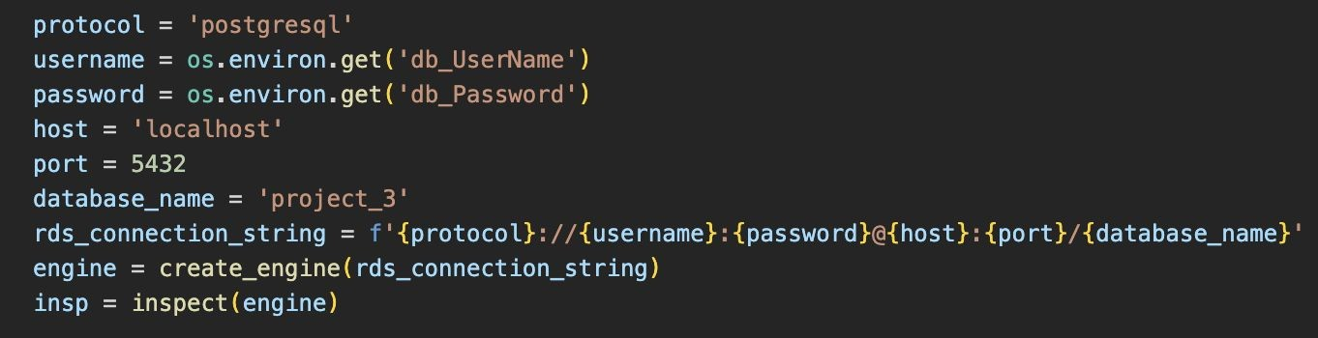
Extract, transform, load
Creating database:
Using pgAdmin, we created a database called project_3 which has two tables called the same way as the csv files used.
Connecting to local database:
With create_engine and inspect, we connected to this local database created (project_3).

Slide 4
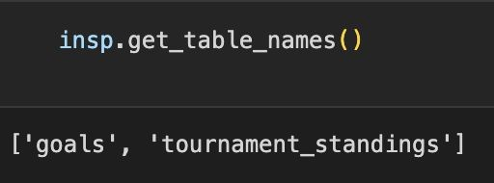
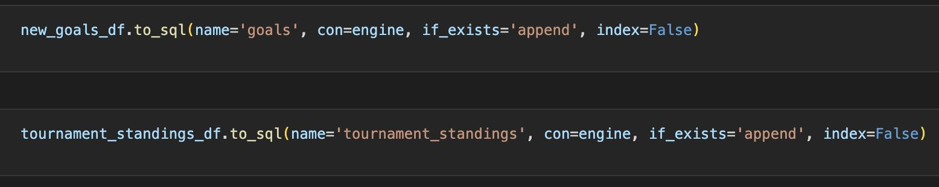
Extract, transform, load
Checking for tables
Loading Dataframe into Database using Pandas
With create_engine and inspect, we connected to this local database created (project_3).

Slide 5
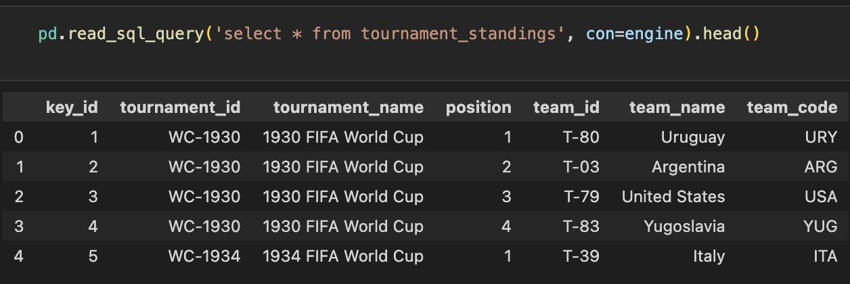
Extract, transform, load
Confirming data has been added by querying the tables names.
(tournament_standings table as an example)

Slide 6

Objective: FIFA World Cup Data Analysis
Number of World Cups won by the countries over the years
How did the competitiveness in the World Cup change over the years
Which country scored maximum number of goals in 1990 ?
Can I get a visual difference between the goals scored by each country in 2012 ?
First four standings in 2006
Which countries are participating in 2022 FIFA World Cup

Slide 7
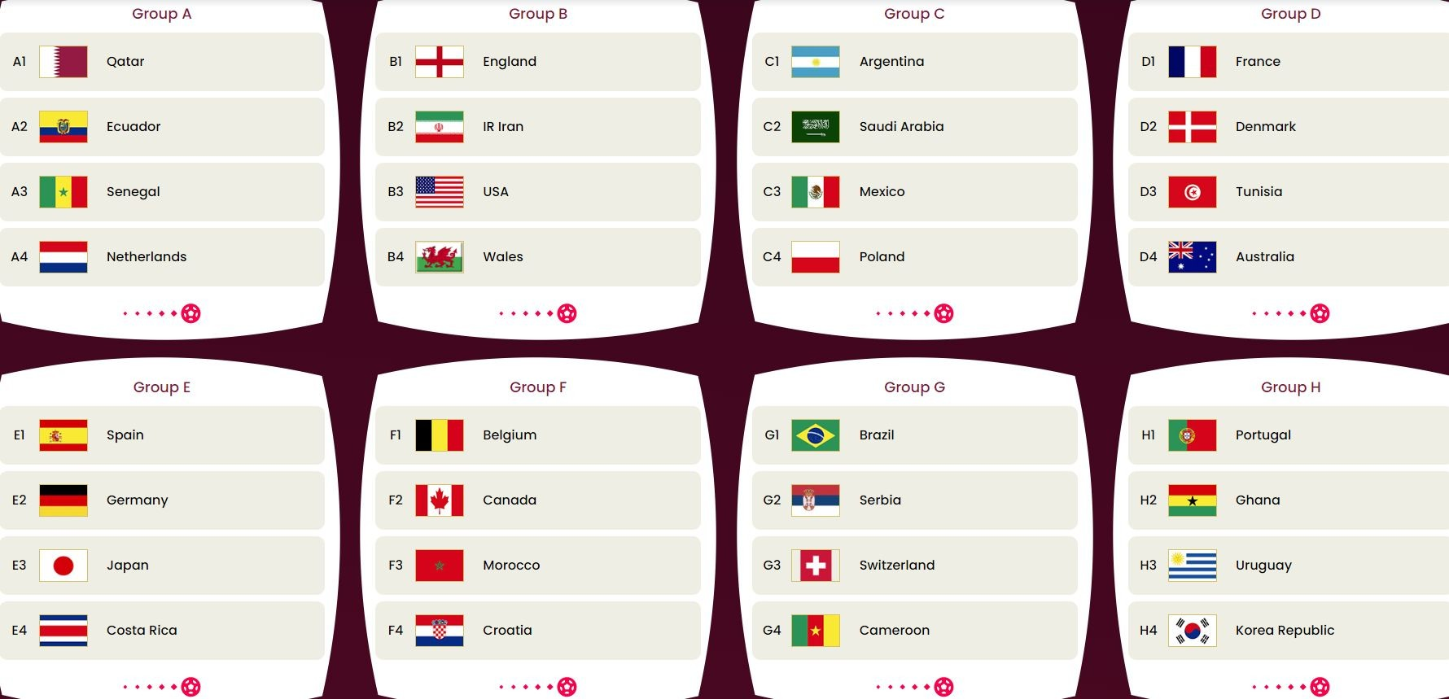
FIFA World Cup 2022 Teams

Slide 8
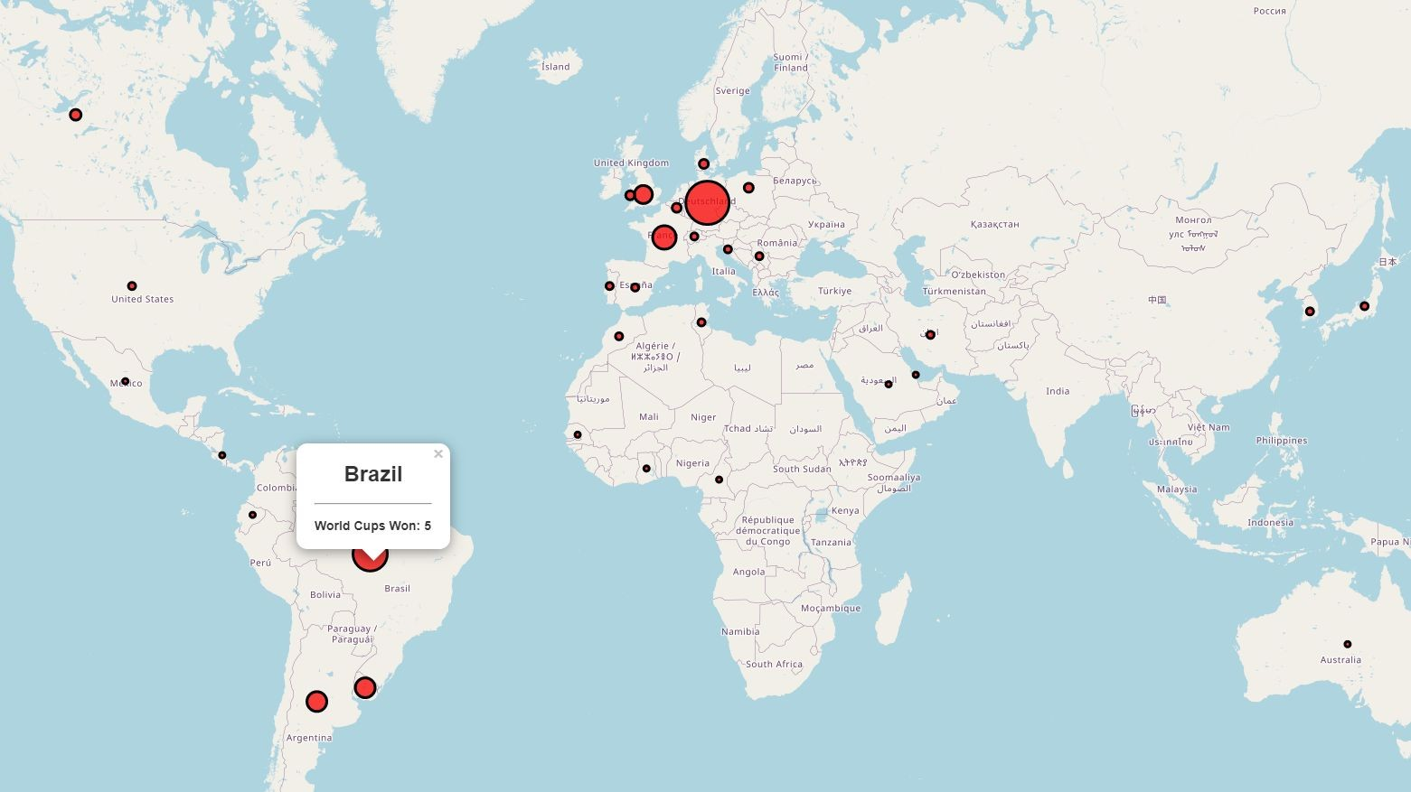

Slide 9
Thank you

